Slide 1
Improving Performance in Cluster-Based Web Applications
Project Members
S Stanley Stanis (31709205114)
A B Shrinivass (31709205104)
Project guide
Ms M Janani

Slide 2
Objective
- To develop a scheduling framework which increases the performance of the server by allocating the requests evenly and balancing the resource utilization of parallel running requests
Abstract

Slide 3
Existing Systems
- Scheduling is based on priorities (EDF-P).
- Data Staleness s = t- r
t = Current Time
r = earlier time the data updated
Issues
- Higher priority tasks of long running time takes longer time to execute
- Low priority jobs of small running time is deferred by higher priority jobs

Slide 4
Proposed System
- Scheduling – Requests are evenly handled since.
- Thread Pool
- Tracks
Advantages
- Both the small and long running jobs are completed in possible minimal time
- Increased throughput
- Resource utilization is balanced

Slide 5
Architecture
Server
Request
Request handler
Response
T1 T2 T3 T4 … … … Tn
Thread Pool
Thread Pool Performance Monitor
Resource aware scheduler

Slide 6
Modules
Request Handler
Request Aware Scheduler
Thread Pool
Thread Pool Performance Monitor

Slide 7
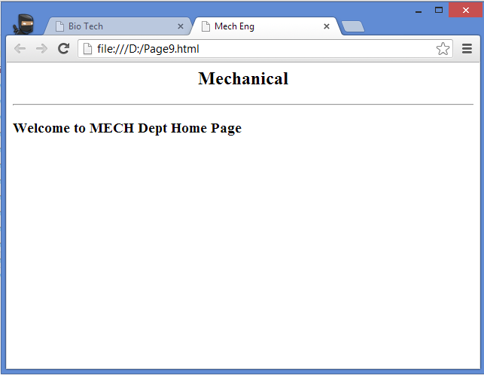
Module Description
Request Handler
-Request arrives at server through n/w protocols or through JMS(Java Message Service) queue
-New thread is created when the request arrives and it is handled in that thread

Slide 8
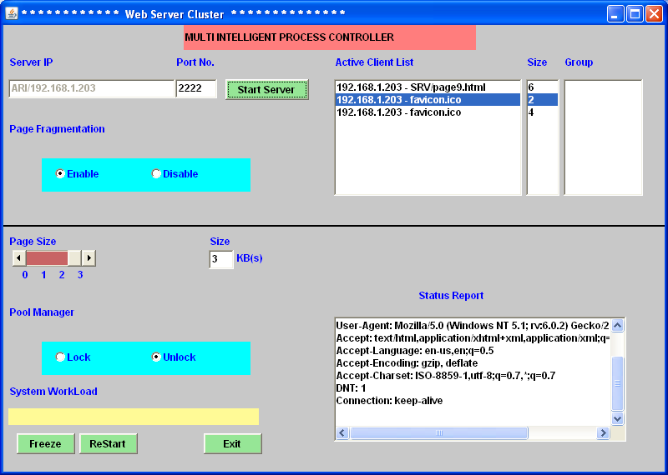
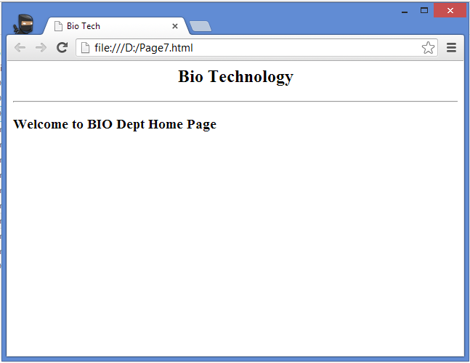
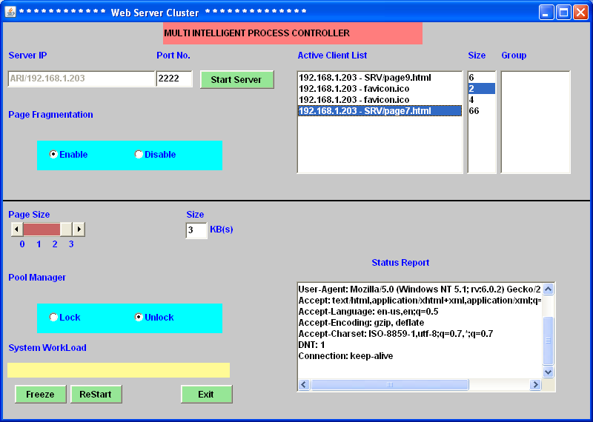

Slide 9
Request Handler
Content Details of Page
Size of the Page
Request
Response Scheduler
URL of Request Page
RH
(Request Handler)

Slide 10
Resource Aware Scheduler
- Resource Controller measures response times for each request passing in to the Thread Pool
- Resource handler is one that receives requests from request handler and redirects it to the thread pools
- Resource aware scheduler keep track of resource utilization levels

Slide 11
Resource Controller
Resource Aware Scheduler
Thread Pool Allocation
FBC (Feed Back Controller)
TPPM (Thread Pool Performance Monitor)
Status Report
URL Alive or Not
Explorer Details
Host Details

Slide 12
Resource Scheduler
Active Client List
URL ID
Page Content Size
URL Size
Memory Size
Request handler
Response Handling the User Request
Group Allocation
Monitor Client (Thread Pool Performance Monitor)

Slide 13
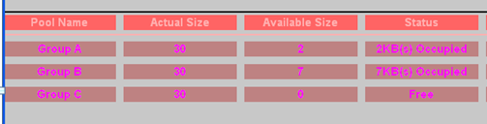
Thread Pool
-Number of threads are created to perform a number of tasks, which are usually organized in a queue

Slide 14
Thread Pool
Thread Pool Memory Size Allocation
Memory Request
Randomized memory Selection
Pool manager Lock & Unlock
TPPM

Slide 15
Thread Pool Performance Monitor
- Response Time Controller
- Fluctuation
- Sends information to resource scheduler in directing the request to the thread pool for better performance and resource utilization

Slide 16
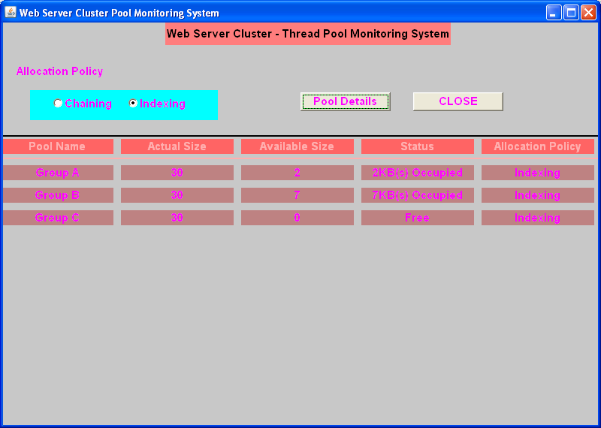


Slide 17
Thread Pool Performance Monitor
Memory Allocation Policy
Pool Names
Thread Pool View
Memory Sizes
Chaining
Indexing
Current Size
Status of Memory
Allocation Policy
…………..
Thread Pool
Thread Pool

Slide 18
Conclusion
Requests are evenly handled and Resource Utilization is very well balanced.
Future Enhancements
The resources used in the tracks are only memory. In future, the other resources are also balanced with real time experimenting.

Slide 19
References
[1] Lukasc Golab, Theodore Johnson, and Vladislav Shkapenyuk, ”Scalable Scheduling of Updates in Streaming Data Warehouse”, in Knowledge and Data Engineering, 2012.
[2] D. Li, J. Wu, Y. Cui, and J. Liu, “QoS-aware streaming in overlay multicast considering the selfishness in construction action," in Proc. IEEE INFOCOM, 2007.
[3] G. Tan and S. Jarvis, “Improving the fault resilience of overlay multicast for media streaming," IEEE Trans. Parallel Distributed Syst., vol. 18, no. 6, pp. 721-734, 2007.
[4] A. T. S. Chan, J. Cao, and C. K. Chan, “Webgop: collaborative web services based on graph-oriented programming," IEEE Trans. Syst., Man, Cybernetics, Part A, vol. 35, no. 6, pp. 1874-1885, 2005.

Slide 20
THANK YOU

